Slide 1

College of Humanities and Social Sciences
FY 2024 Planning and Budget Meeting

Slide 2
College of Humanities and Social Sciences
Academic / Division Departments
  Communication Studies
  English
  History
  Political Science
  Psychology and Philosophy
  Sociology
  World Languages and Cultures
Centers
  Center for Multicultural Rural Development
  Psychological Services Center
  Texas Review Press

Slide 3
FY 2023 Accomplishments
Priority 1: Prioritize Student Success and Student Access
  Developed a new MA in History and Political Studies, a new minor in Medical Humanities and Social Sciences, and two undergraduate certificates in Communication for Sport Professionals and Communication for Legal and Criminal Justice Professionals. (Department of History, Department of Political Science, and Department of Communication Studies)
  Hosted the first Career and Internship Fair for CHSS majors and minors in collaboration with Career Success Center.
  Established CHSS Experiential Learning Scholarship to promote the learning and development of knowledge and skills from direct experience such as internship and practicum.
  Increased funding support for CHSS faculty-mentored undergraduate research from 4 students in FY22 to16 students in FY23.

Slide 4
FY 2023 Accomplishments
Priority 2: Embody a Culture of Excellence
  Established seven CHSS faculty-led collaborative research clusters through an internal grant to encourage interdisciplinary, team-based research.
  Converted 10 full-time pool faculty positions to lecturer positions through internal budget reallocation to ensure greater personnel stability for course delivery.
  Completed the CHSS climate survey and shared the results with faculty and staff.
  Developed the college guidelines and departmental standards to align with the newly revised APS 900417.

Slide 5
FY 2023 Accomplishments
Priority 3: Elevate the Reputation and Visibility of SHSU
  Hosted Pulitzer and National Book Award winner Adam Johnson. (November 10, 2022) (Department of English)
  Hosted the 30th annual conference (2023) of the North American Society for the Study of Romanticism (NASSR), attended by approximately 200 scholars. (March 30 to April 1, 2023) (Department of English)

Slide 6
FY 2023 Accomplishments
Priority 4: Expand and Elevate our Service to the State and Beyond
  Expanded public history internship program to include partners of museums and historical sites in various parts of Texas. (Department of History)
  Provided low-cost clinical services to underserved communities. (Psychological Services Center)
    In 2022, 34.38% of services provided were to minority patients and 81.25% were provided to low-income patients

Slide 7
Budget Request
#1 Budget Priority | Convert Nine Full-time Pool Faculty Positions to Lecturer Positions
Aligned with Strategic Priority Goal | Strategic Priority 2 Goal 1: Academic Excellence.
Amount Requested | $213,840
Frequency of Need | Recurring
Opportunity Statement | Nine lecturer positions will offer greater support to recruit and retain faculty. It ensures more flexibility and stability in course scheduling and delivery for student success during the time of economic uncertainty.
Risk Statement | If not funded, we run the risk of not retaining qualified faculty members to provide quality education for SHSU students.

Slide 8
Budget Request
#2 Budget Priority
What is the request?
#2 Budget Priority | Increase CHSS Graduate Assistant Pay
Aligned with Strategic Priority Goal | Strategic Priority 1 Goal 1: Recruit, retain, graduate, and empower students to drive sustainable growth.
Amount Requested | $133,056
Frequency of Need | Recurring
Opportunity Statement | CHSS graduate assistants’ pay has not increased since the college was established in 2003. To increase their pay from $9,846 to $13,014 for the 42 GA’s in CHSS Master’s programs will help support graduate students and attract quality applicants to SHSU.
Risk Statement | SHSU is behind other peer universities in supporting graduate students. If not funded, we will encounter increasing difficulty in recruiting qualified students for graduate programs.

Slide 9
Budget Request
#3 Budget Priority
What is the request?
#3 Budget Priority | Salary Increase for Promotion of Eligible Lecturers to Senior Lecturers
Aligned with Strategic Priority Goal | Strategic Priority 2 Goal 1: Academic excellence.
Amount Requested | $51,480
Frequency of Need | Recurring
Opportunity Statement | The opportunity to be promoted to senior lecturers with a salary increase offers career advancement for eligible lecturers. It helps encourage them to stay at SHSU and continue their contributions to student success.
Risk Statement | If not funded, we may lose highly qualified faculty to other institutions.

Slide 10
Budget Request
#4 Budget Priority
What is the request?
#4 Budget Priority | Replace 10-year-old Canon copier in main POLS workroom (HEF Eligible)
Aligned with Strategic Priority Goal | Strategic Priority 2 Goal 2: Align processes and resources, such as staffing, facilities, technology, and other assets to strategic priorities.
Amount Requested | $9,850
Frequency of Need | One-time
Opportunity Statement | Replacing the old copier helps increase operational efficiency and effectiveness and reduce maintenance cost required for an out-of-date machine.
Risk Statement | Substandard operating equipment will result in inefficiencies and ineffectiveness of departmental operations while increasing maintenance costs to upkeep an out-of-date machine.

Slide 11
Budget Request
#5 Budget Priority
What is the request?
#5 Budget Priority | Student Fellowships for MFA in Creative Writing, Editing, and Publishing
Aligned with Strategic Priority Goal | Strategic Priority 1 Goal 1: Recruit, retain, graduate, and empower students to drive sustainable growth.
Amount Requested | $60,000
Frequency of Need | Recurring
Opportunity Statement | MFA in Creative Writing, Editing, and Publishing competes nationally for students. The program’s association with the National Book Foundation Internship program and its affiliation with the Texas Review Press (AUP member) are attractive to students. The fellowships will provide competitive funding for students and further enhance the reputation of the program.
Risk Statement | If not funded, we limit our ability to recruit the most talented and creative students in a very competitive market.

Slide 12
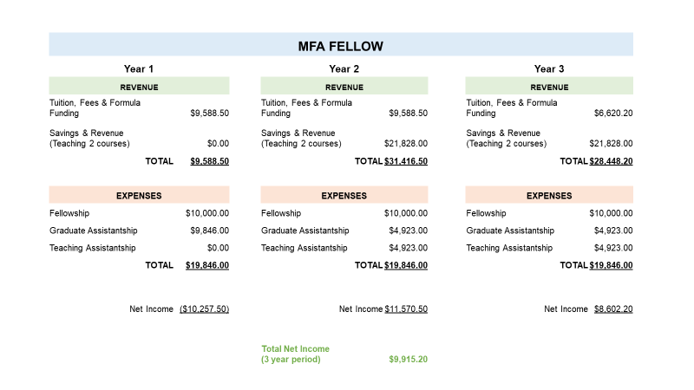
Supportive Data

Slide 13
Summary of Budget Requests
Convert Nine Full-time Pool Faculty Positions to Lecturer Positions – $213,840
Increase CHSS Graduate Assistant Pay – $133,056
Salary Increase for Promotion of Eligible Lecturers to Senior Lecturers – $51,480
4. Replace 10-year-old Canon copier in main POLS workroom (HEF Eligible) – $9,850
5. Student Fellowships for MFA in Creative Writing, Editing, and Publishing – $60,000
*Total Amount Requested – $468,226

Slide 14
Self-funded New Initiatives
    One new lecturer position for Communication Studies $55,456
    (Strategic Priority 1: Prioritize Student Success and Student Access)
    2. Increase Graduate Assistant Pay for 5 CHSS-funded Graduate Assistants (Strategic Priority 1: Prioritize Student Success and Student Access)

Slide 15
Prospective “Big Ideas”
Comprehensive Evaluation of Space Utilization and Needs for CHSS Units
Explore Measures to Enhance Faculty and Staff Retention

Slide 16
Questions?

